Slide 1

BCA Ist Semester Introduction of Logic Circuit and Digital Design(ILCDD) Course Code: BCAC0003
Presented by:
Mr.Anuj Kumar
Assistant Professor, Dept. Of CEA
GLA University, Mathura

Slide 2
Logic gates & truth table.

Slide 3
Binary Logic
Definition of Binary Logic
Binary logic consists of binary variables and a set of logical operations.
The variables are designated by letters of the alphabet, such as A, B, C, x, y, z, etc, with each variable having two and only two distinct possible values: 1 and 0,

Slide 4
Logic gates
Logic gates are the basic building blocks of any digital system.
It is an electronic circuit having one or more than one input and only one output.
The relationship between the input and the output is based on a certain logic.
Three basic logical operations:
AND
OR
NOT.

Slide 5
AND Gate
The AND gate is an electronic circuit that gives a high output (1) only if all its inputs are high. A dot (.) is used to show the AND operation i.e. A.B. Bear in mind that this dot is sometimes omitted i.e. AB
Truth Tables, Boolean Expressions are
X | y | z
0 | 0 | 0
0 | 1 | 0
1 | 0 | 0
1 | 1 | 1
z = x • y = x y

Slide 6
OR Gate
The OR gate is an electronic circuit that gives a high output (1) if one or more of its inputs are high. A plus (+) is used to show the OR operation.
x | y | z
0 | 0 | 0
0 | 1 | 1
1 | 0 | 1
1 | 1 | 1
z = x + y

Slide 7
NOT Gate
The NOT gate is an electronic circuit that produces an inverted version of the input at its output. It is also known as an inverter. If the input variable is x, the inverted output is known as NOT x. This is also shown as x', or x with a bar over the top.
x | z
0 | 1
1 | 0
z = x’

Slide 8
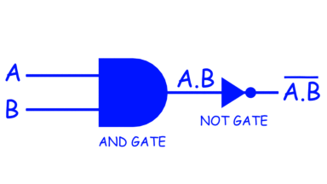
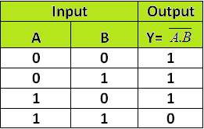
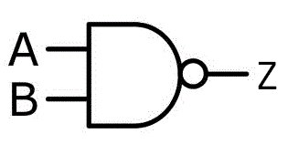
NAND Gate
A NAND gate (NOT-AND) is a logic gate which produces an output which is false only if all its inputs are true; thus its output is complement to that of an AND gate. A LOW (0) output results only if all the inputs to the gate are HIGH (1); if any input is LOW (0), a HIGH (1) output results.
Truth Table of NAND Gate

Slide 9
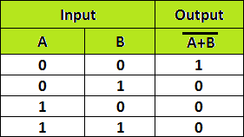
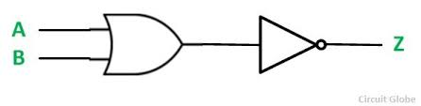
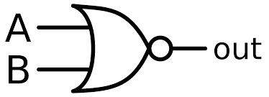
NOR Gate
The NOR gate is a digital logic gate that implements logical NOR -
A HIGH output (1) results if both the inputs to the gate are LOW (0); if one or both input is HIGH (1), a LOW output (0) results.
NOR is the result of the negation of the OR operator.
Truth Table of NOR Gate

Slide 10
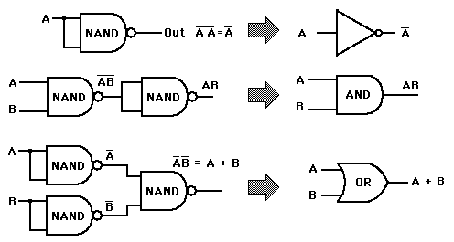
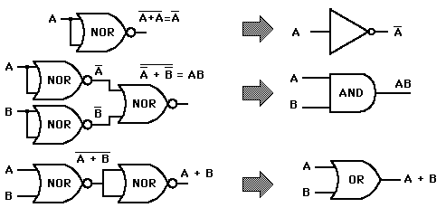
Universal Gate
NAND and NOR Gates are called Universal Gates because AND, OR and NOT gates can be implemented &created by using these gates.
NAND Gate Implementations NOR Gate Implementations

Slide 11
Special Purpose Gate
EX-OR Gate
EX-NOR Gate

Slide 12
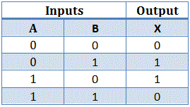

EX-OR Gate
Exclusive OR gate –
is a digital logic gate that gives a true (i.e. a HIGH or 1) output when the number of true inputs is odd. ...
An XOR gate is normally two inputs logic gate where the output is only logical 1 when only one input is logical 1
(A’.B) + (A.B’) or A ⊕ B
Truth Table of EX- OR Gate

Slide 13
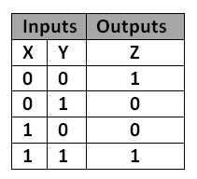
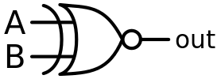
EX-NOR Gate
An XNOR gate (sometimes referred to by its extended name, Exclusive NOR gate)
It is a digital logic gate with two or more inputs and one output that performs logical equality.
The output of an XNOR gate is true when all of its inputs are true or when all of its inputs are false.
(A.B) + (A.B)’ or ( A ⊕ B)’
Truth Table of EX-NOR Gate

Slide 14
